Slide 1
Forest Cover type Prediction
Ativ Aggarwal
Krishna Vamsi Chandu
NEil Champakara
Shariq Rahman

Slide 2
Introduction
The goal is to predict the forest cover type using strictly cartographic variables.
The actual forest cover type was determined from US Forest Services (USFS).
Independent variables were then derived from data obtained from the US Geological Survey and USFS
Area includes four wilderness areas located in the Roosevelt National Forest of northern Colorado.

Slide 3
Features of the dataset
Elevation – meters
Aspect – degrees azimuth
Slope - Degrees
Horizontal Distance to Hydrology - meters
Horizontal Distance to Roadways - meters
Horizontal Distance to Fire Points - meters
Hill shade at different times (9 AM, Noon, 3pm) – 0 – 255 index
Soil Composition ( 40 types of soil) – binary (Present or not)

Slide 4
Features of the dataset
581012 total entries
No missing data in the data set
7 types of forest cover types.
1 - Spruce/Fir 2 - Lodgepole Pine 3 - Ponderosa Pine 4 - Cottonwood/Willow 5 - Aspen 6 - Douglas-fir 7 – Krummholz
Classification task – Multi class

Slide 5
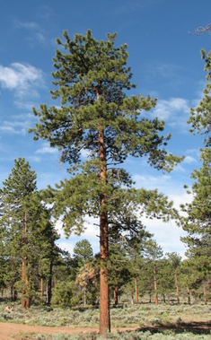
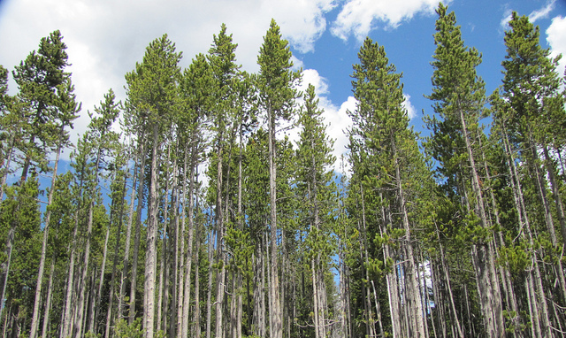
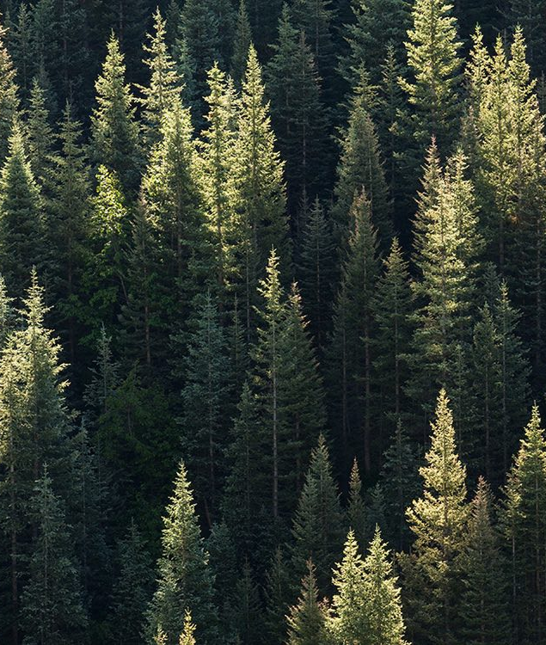
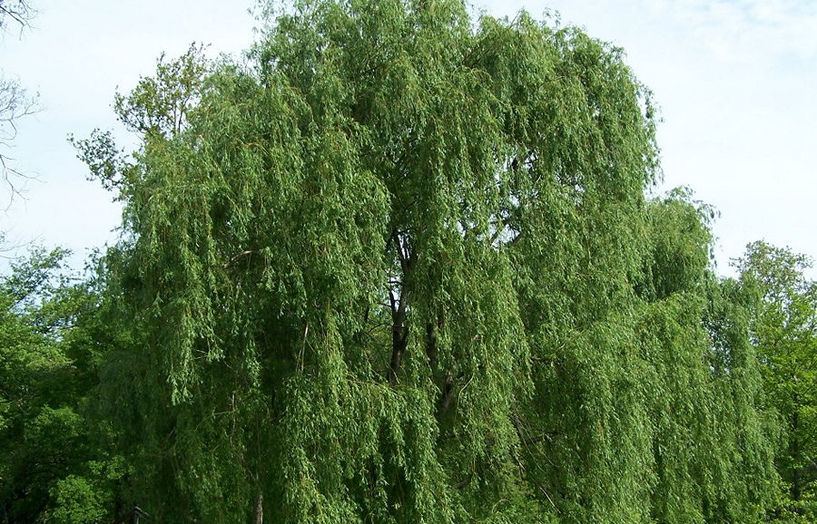
7 Classifications
Spruce/Fir
Lodgepole Pine
Ponderosa Pine
Cottonwood/Willow
Aspen
Douglas-fir
Krummholz

Slide 6
Approach used
Load data from data set.
Prepared the data and performed basic analysis on useful features.
Performed data standardization
Try different models.
Evaluate using: accuracy, confusion matric, cross validation scores.

Slide 7
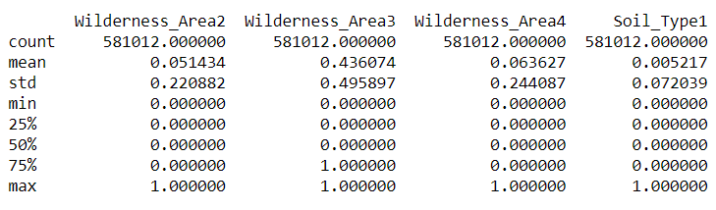
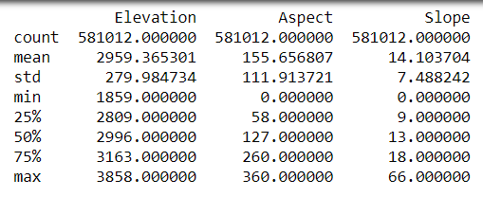
Before data standardization
All the features are numerical but belong to different units and different scales.
Resulted in bad accuracies.

Slide 8
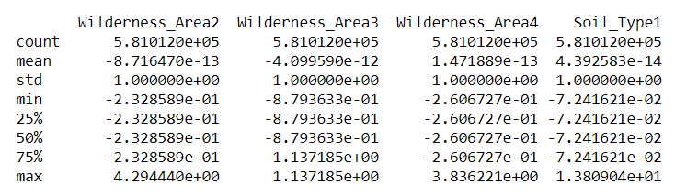
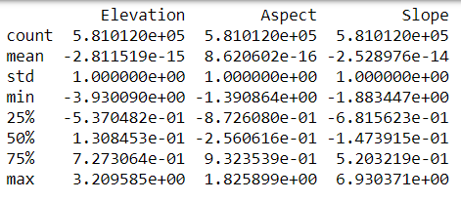
After data standardization
An attempt to make all units of the same scale.
For each field: standardized x = (x – mean)/std_deviation
Resulted in all the fields in a similar scale. Improved accuracy of the models.

Slide 9
Models used
Naïve Bayes
SGD Classifier
SGD Classifier with RBF Sampling (Kernel approximation)
K Nearest Neighbours
Linear Regression
XGBoost Classifier
2 layered Neural Network

Slide 10
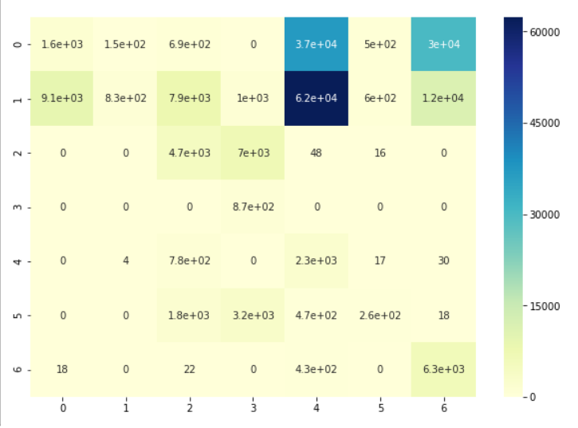
Naïve Bayes
Used Naïve Bayes implementation from scikit-learn library.
Measured Accuracy : 8.7%
3 fold cross validation score: 0.13

Slide 11
K Nearest Neighbours
Implemented the K Nearest Neighbors classifier on the data set using the implementation provided by the scikit-learn library.
Since the dataset was huge and the algorithm is a lazy algorithm, we could not compute the confusion matrix, and cross validation scores.
Testing accuracy: 92.33%
Training accuracy: 94.34%

Slide 12
Logistic Regression
Performed Logistic Regression implementation available in the scikit-learn library.
Set the l2 regularization constant to 1 to prevent overfitting.
Training accuracy : 31.99 %
Testing accuracy : 31.86 %
3 fold cross validation score : 6.25

Slide 13
XGBoost Classifier
Used Extreme Gradient Boosting, which uses a tree classifier, provided by xgboost library in python.
Testing accuracy : 74.44%
Training accuracy : 74.55%
3 fold cross validation score : 61.8

Slide 14
2 layered Neural Network
Used a simple 2 layered Neural Network. Used the keras library to create layers and computations.
Structure of our neural network : 54 inputs -> (Dense layer with 8 neurons) -> (Output layer 7 neurons)
RelU function for the inner layer, and softmax algorithm for the output layer.
After 150 epochs :
Testing accuracy : 72%
Training accuracy : 75.14%

Slide 15
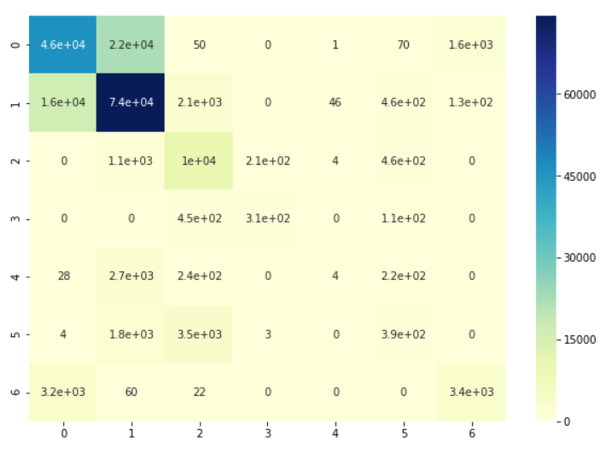
SGD Classifier
Stochastic Gradient Descent algorithm, inspired from the Machine Learning cheat sheet provided by the scikit-learn library, to try to improve the accuracy.
Training accuracy : 73.34%
Testing accuracy : 70.19%
3-fold cross validation score : 61%

Slide 16
SGD Classifier with RBF Sampling (Kernel approximation)
Another optimization technique intended to improve the accuracy of the SGD Classifier.
Tries to map the 54 features to 100 features, and use SGD Classifier.
Training accuracy: 51.34%
Testing accuracy : 48.65%
3 fold cross validation score : 59.88%

Slide 17
Results
K Nearest Neighbors provided the best accuracy scores.
The neural network has the stable testing and training scores, which can be further improved with a different structure of neural network and different activation function.
XG Boost is another promising algorithm with good training and testing accuracies.
Naïve Bayes was bad, because the data is not expected to be conditional which is the basic principle of the algorithm.

Slide 18
What we learned..
We were able to try out various different machine learning models, and able to relate it to our database.
Feature selection and data standardization was very important and helped the accuracies much better.
Learned how to evaluate the performance of a model, and how to decide on what model is the better one for a given dataset.

Slide 19
What can be done in the future.
Future selection can be done in a much better way, by dropping few entries which are not very important.
Different structures of neural networks can be tried because it was a promising model.
Confusion matrix and cross validation should be performed on K Nearest Neighbors Classifer to evaluate it much better as a viable model for the data set.
Try more approaches like Random Forests, and other decision trees, etc.

Slide 20
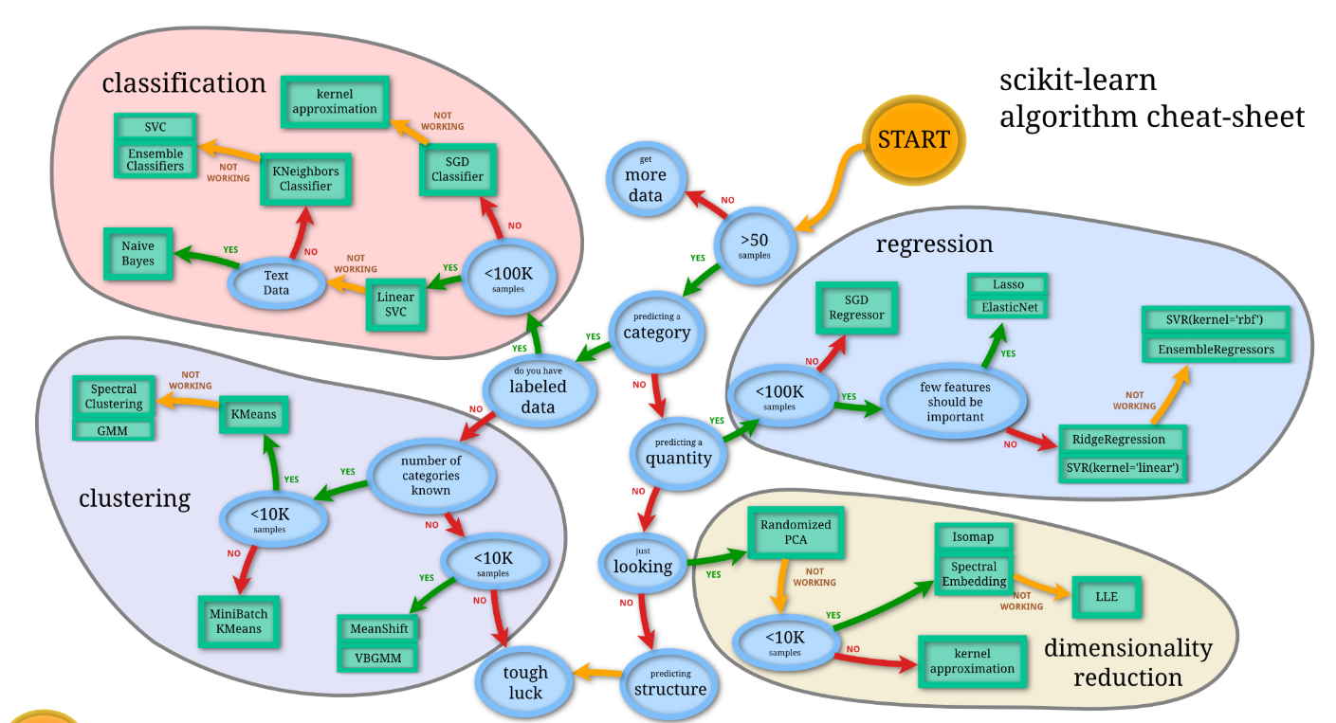
Inspired from

Slide 21

Thank you

